Slide 1


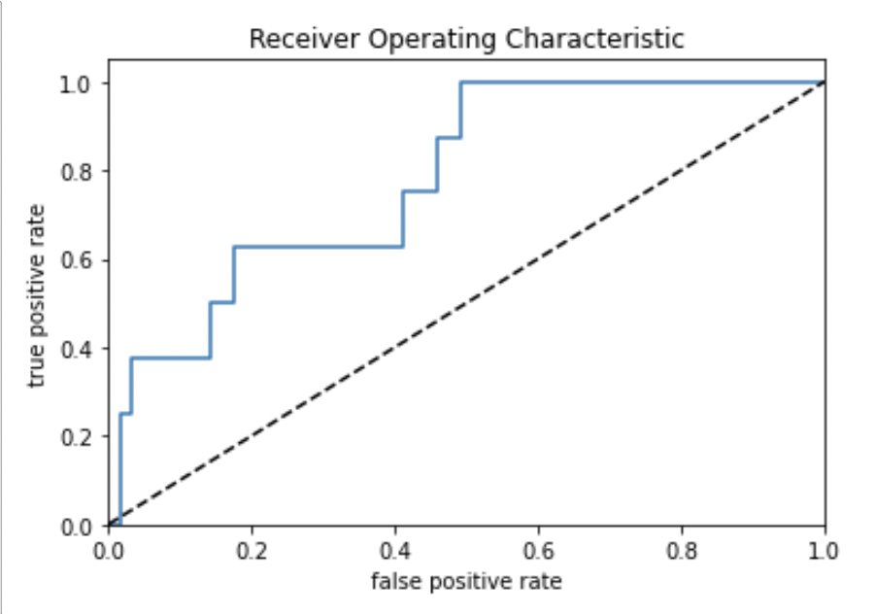
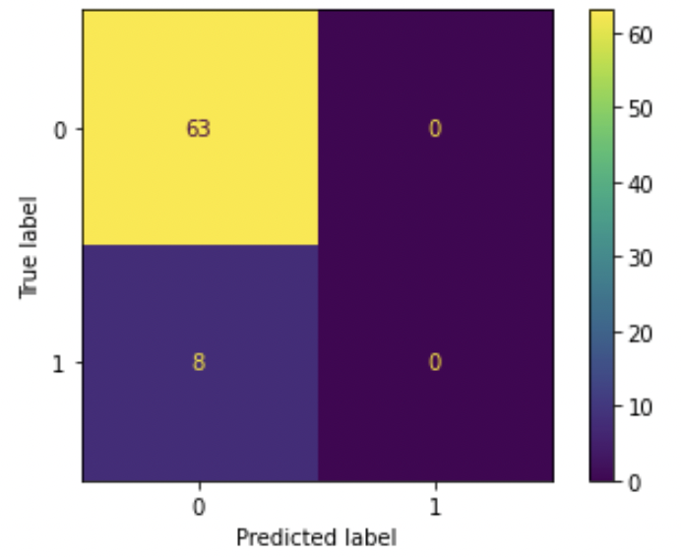
CUSTOMER CLASSIFICATION - Bank Case Study
HYPOTHESIS:
Ho: the model CAN NOT predict accurately whether new customers will be “good” or “bad”.
Ha: the model CAN predict accurately whether new customers will be “good” or “bad”.
STRATEGIC IMPACT:
An accurate logistic model would allow the bank to increase efficiency whilst mitigating risk and avoid bankrupcy. It other words, it would help in becoming more profitable as well as more reliable.
VISUALISING ACCURACY:
NEXT STEPS
The model is not ready to be deployed, however, the following measures could be applied to improve its accuracy:
Get new data points:
External: such as income, household income
Internal: obtaining gender from birthdate
Apply feature engineering to existing columns
Drop highly correlated fields
“Play” with the % of data assigned to training and testing
Apply SMOTE and TOMEK LINKS methods to deal with unbalanced data
Keep iterating until we either proof Ha or we confirm Ho.
ROC curve plot (left) shows the model is better at predicting than the threshold (dotted line), accuracy being 78%
Confusion Matrix (right) is showing that the model was not capable of predicting ”bad” customers (status B)

